Slide 1
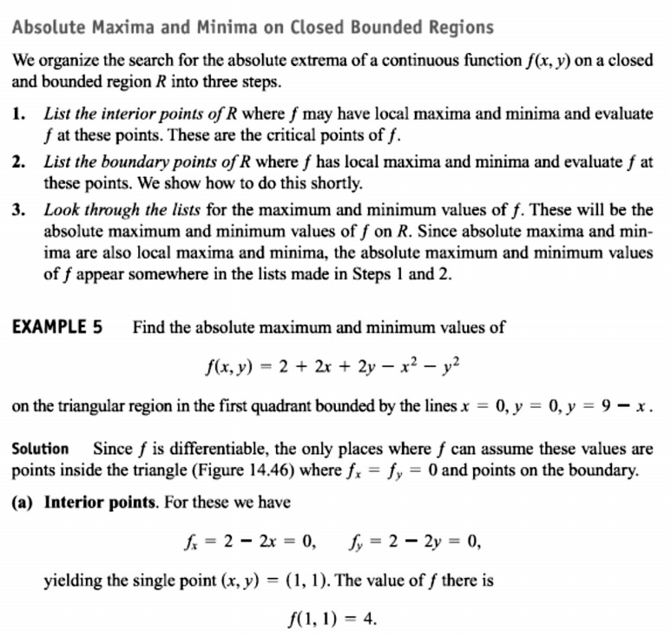
29 / Dep. Of Engineering Mechanics
th
Class: 2 AMTHMATICS / T he Partial Derivatives

Slide 2
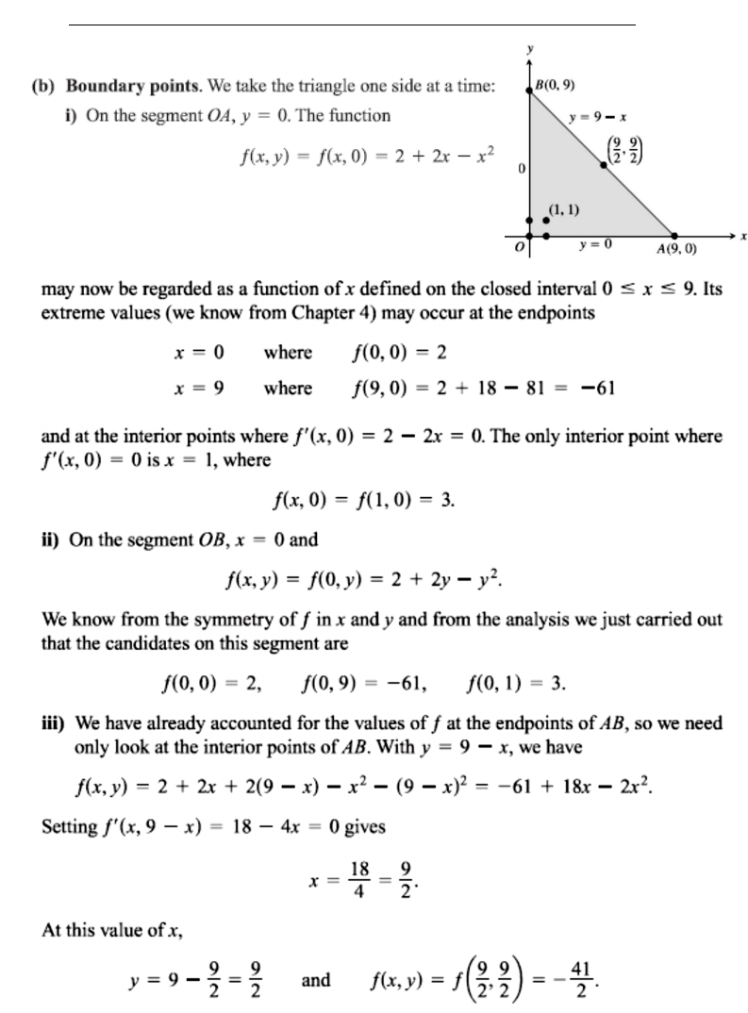
30 / Dep. Of Engineering Mechanics
th
Class: 2 AMTHMATICS / T he Partial Derivatives

Slide 3
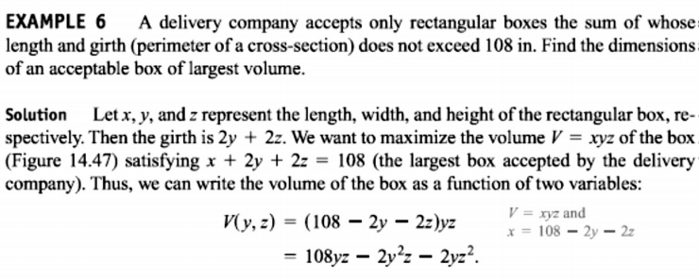
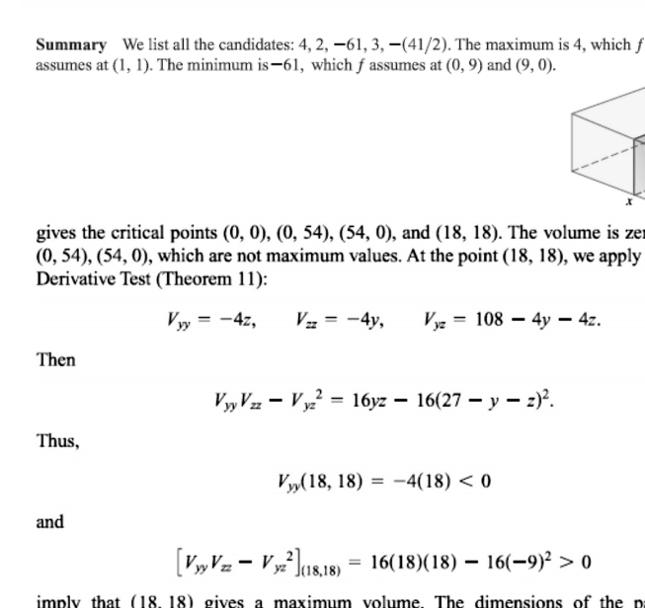
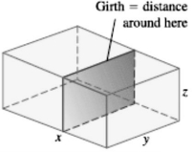
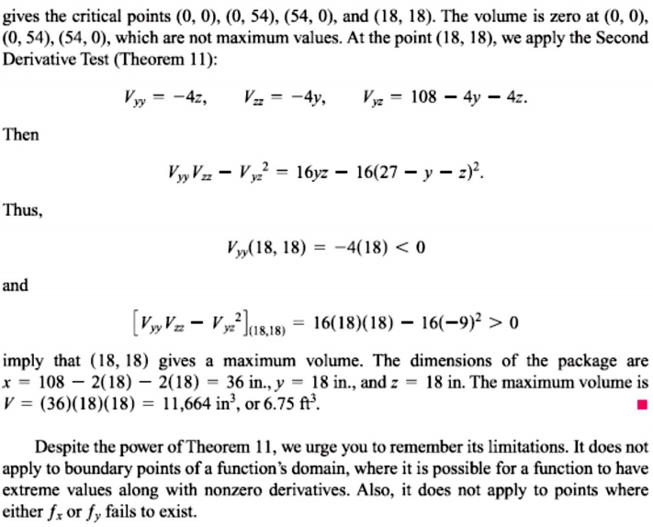
31 / Dep. Of Engineering Mechanics
th
Class: 2 AMTHMATICS / T he Partial Derivatives

Slide 4
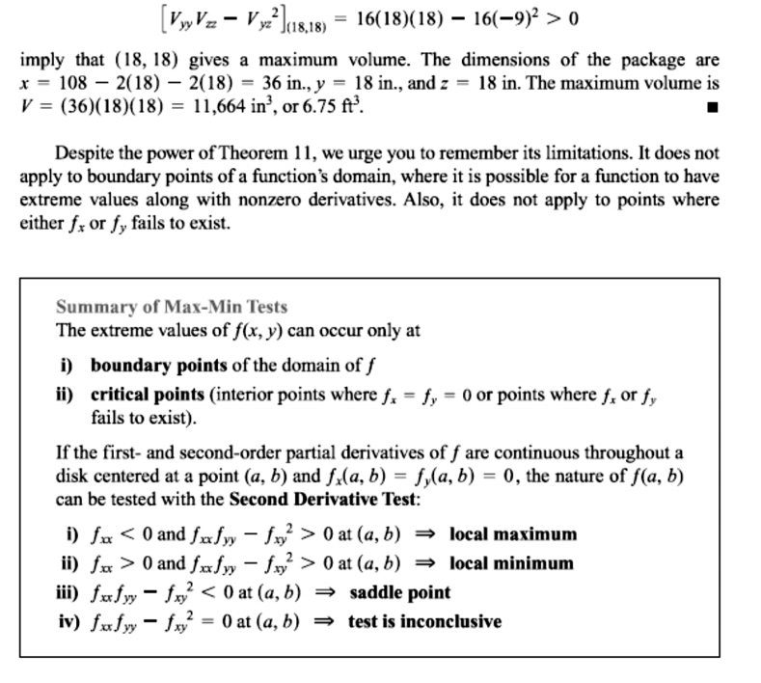
32 / Dep. Of Engineering Mechanics
th
Class: 2 AMTHMATICS / T he Partial Derivatives

Slide 5
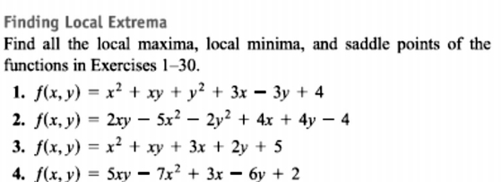
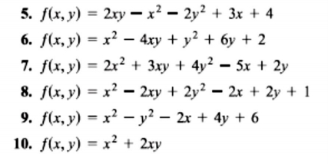
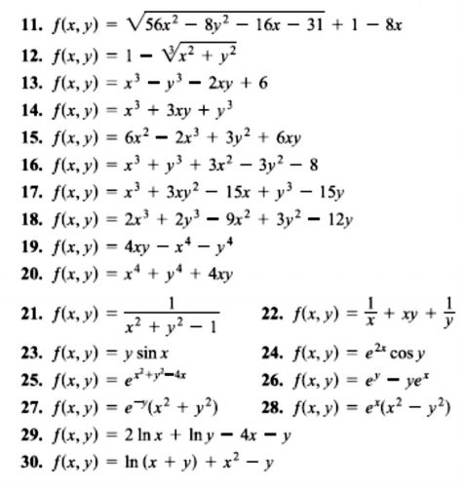
33 / Dep. Of Engineering Mechanics
th
Class: 2 AMTHMATICS / T he Partial Derivatives

